Slide 1
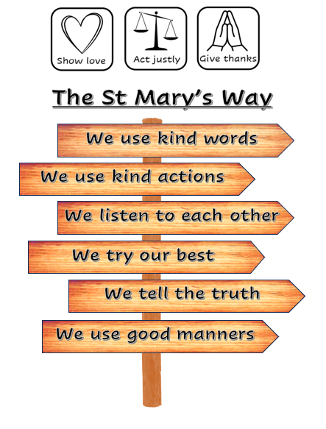
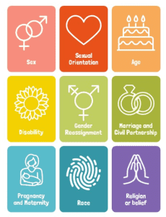





Personal Development at St Mary’s
Together we love, learn and flourish
‘Let all you do be done with love’ 1 Corinthians 16:14
Our vision for children’s personal development
We want our children to become curious, courageous and compassionate individuals. Children who have a thirst for knowledge and are confident to ask questions. Children who are encouraged to share their thoughts and opinions and to stand up for those who are in need. Children who have the self-belief that they are worthy individuals and children that show love and kindness to others, no matter their faith, culture or background. We want our children to know and understand what equality means and to see that being different and unique is great!
It is our aim for children to become responsible, respectful and active citizens.
How is personal development curriculum delivered at St Mary’s?
At St Mary’s, children access personal development sessions which combine personal, social, health and economic education (PSHE) and includes the teaching of relationships and sex education (RSE). This personal development curriculum is split into these key areas; Relationships, Living in the wider world and Health and wellbeing. Children access these sessions weekly in all classes and the themes. Through the implementation of the ‘St Mary’s Way’ children are taught to follow our core values of ‘Show Love, Act Justly & Give Thanks’. Children are encouraged to reflect on their own thoughts and feelings through restorative practice – conversations with children to unpick how they behave and become responsible for their own actions. Our cultural capital offer seeks to provide opportunities and experiences to enrich their lives and enable them to flourish whilst developing socially and spiritually. We promote children’s understanding of the fundamental British Values within collective worship, the use of weekly picture news resources, the considerate selection of curriculum resources and exposure to a range of high-quality texts throughout school. Children are also taught about inclusivity and being considerate of others irrespective of their circumstances so that no discrimination exists. We use the symbols below to raise awareness of these discussions.
British Values at St Mary’s
Equality and diversity

Slide 2
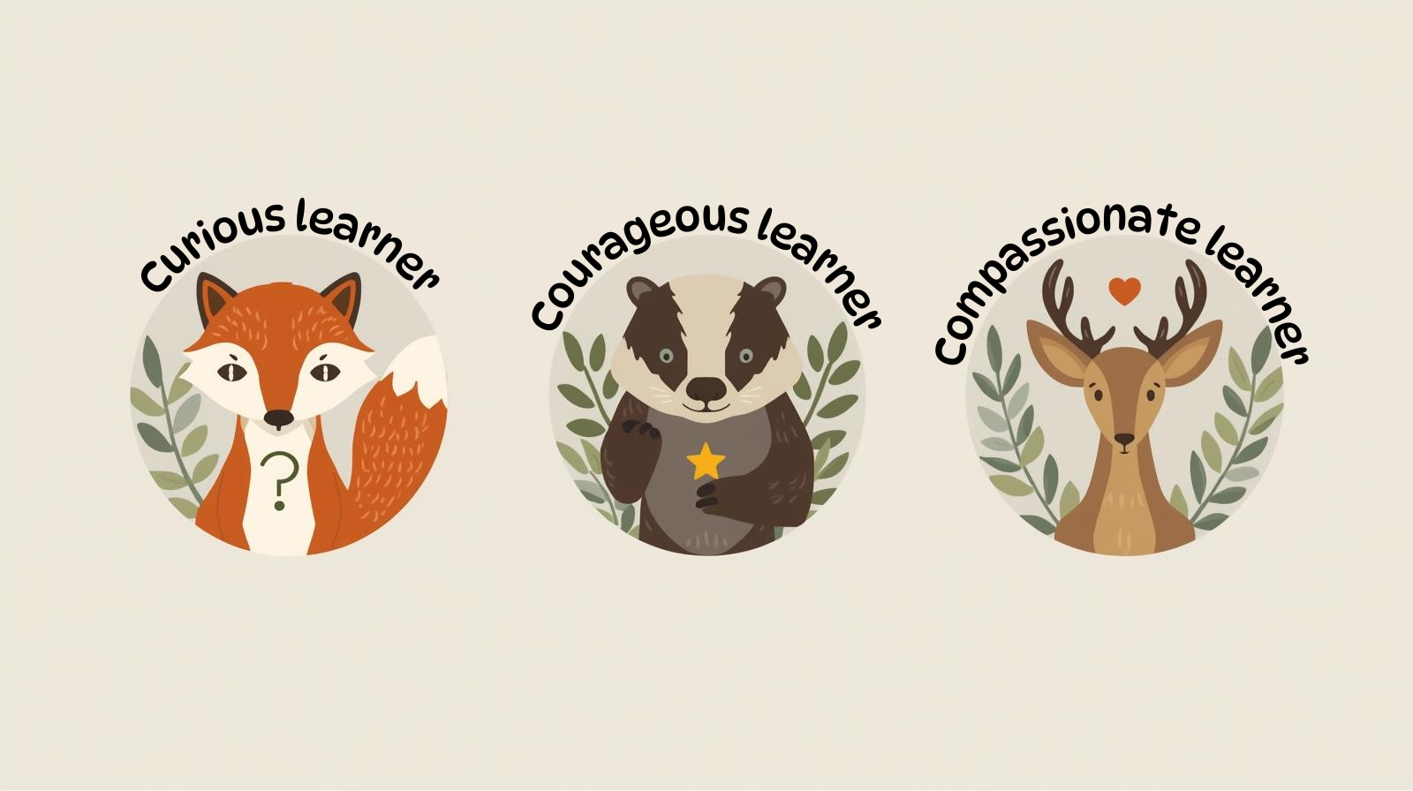
Cultural Capital at St Mary’s
Together we love, learn and flourish
‘Let all you do be done with love’ 1 Corinthians 16:14
Developing Lifelong Learners
Learning at St Mary’s aims to be engaging, exciting, and meaningful. Through carefully planned teaching and a broad range of enrichment experiences, we aim to open doors to new opportunities, inspire curiosity, and deepen children’s understanding of the world around them.
We want our children to be curious, courageous and compassionate learners.
Curious – asking questions, exploring ideas, and developing a love of learning.
Courageous – taking risks in their learning, persevering through challenges, and standing up for what is right.
Compassionate – showing kindness, empathy, and respect for others, and seeking to make a positive difference in their community and beyond.
How?
Why?
When?
What?
Awe & wonder
Persevere
Determined
Resilient
Confident
Brave
Loving
Caring
Thoughtful
Positive mindset
Social, Moral, Spiritual, Cultural Development

