Slide 1
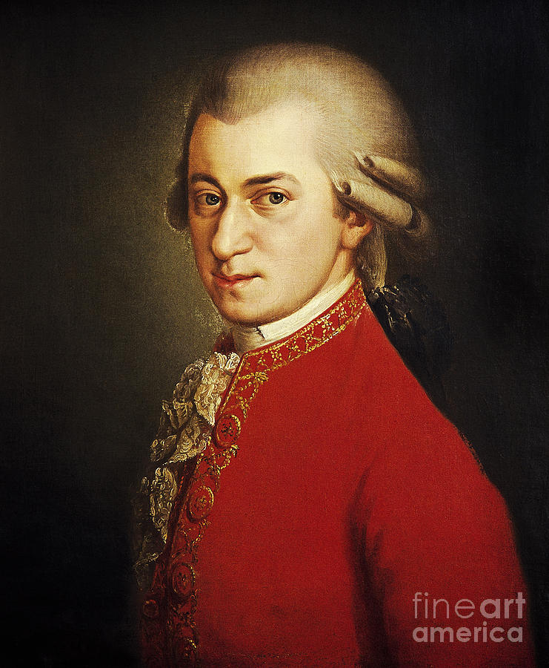
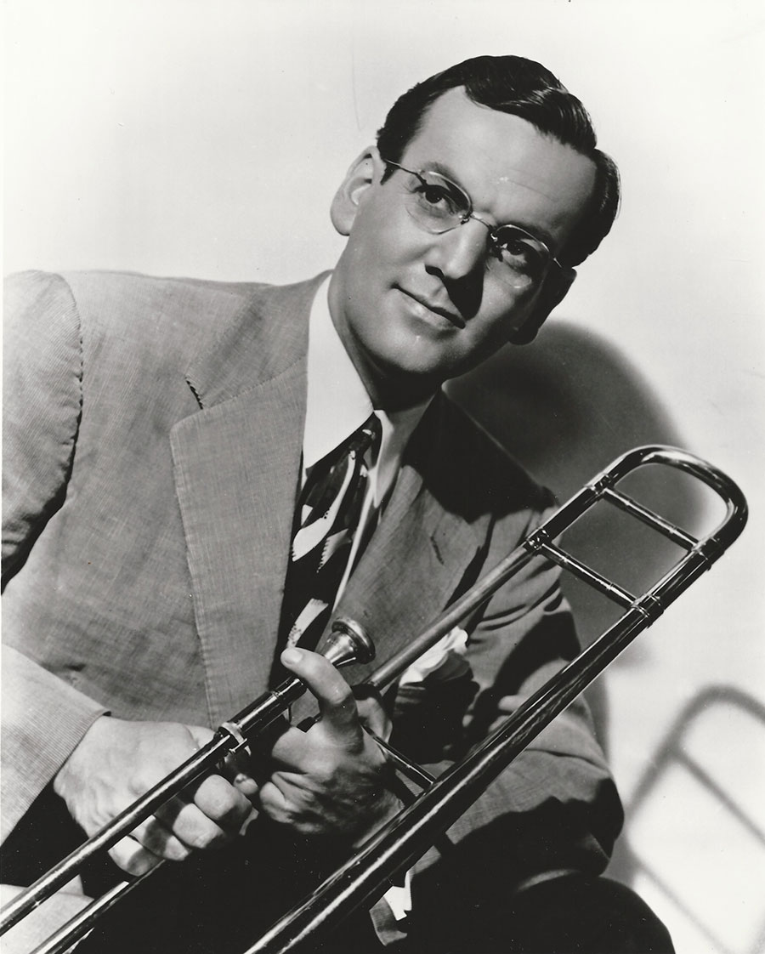

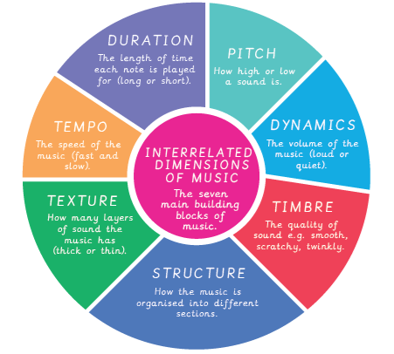
Music at St Mary’s
Together we love, learn and flourish
‘Let all you do be done with love’ 1 Corinthians 16:14
Our vision for Music
We aim to create a vibrant learning environment where every child feels inspired to explore music with curiosity, courage, and compassion. We develop the children’s musical appreciation through listening and appraising rhythm and melody, encouraging children to express themselves and discover new ways to communicate through music.
We want our children to develop a genuine curiosity about the diverse musical traditions, instruments, and cultures from around the world. We inspire them to explore the rich textures of music, to ask questions about how music works, and to find joy in the act of discovery as they begin to create and perform their own musical pieces. We encourage our children to approach music with courage, inviting them to take risks, perform confidently, and embrace the process of learning, even when faced with challenges. By experimenting with different sounds, styles, and instruments, they build resilience and trust in their abilities, developing a lifelong love for music. We want our children to have compassion—for themselves, for others, and for the world around them. Through collaborative music-making and understanding different cultural expressions, they develop empathy and respect for diverse musical voices. Our curriculum inspires children to recognise the power of music to bring people together, heal, and inspire positive change.
Inspiring our children
Children will be encouraged to learn about significant musicians and composers, from classical to modern, exploring a variety of music genres, as well as music from other cultures. Such significant individuals include Mozart, Glenn Miller and Koji Kondo.
How is Music taught at St Mary’s?
At St Mary’s Music is taught using Kapow Primary, which provides a clear and progressive framework to support high-quality teaching and learning. Lessons are planned in line with the National Curriculum, with Music taught weekly across the school, in half-term units. Teachers also use Music as a vehicle to enrich other areas of the curriculum, ensuring music, creativity and performance is embedded throughout children’s learning experiences.​
Our long-term plan provides an overview of the units taught in each year group. These are revisited and built upon term by term, supporting children to make progress through a spiral curriculum. ​
​
Through the spiral curriculum, the children will
have ample opportunity to explore the seven
musical elements:
Pitch – high and low notes used to make
melodies
Duration – long and short notes which are
combined to create rhythms
Dynamics – loud and quiet notes used for
impact
Tempo – fast and slow pulse/beat
Texture – the layers of sound
Structure – repeated patterns, such as
verse/chorus
Timbre – the quality/tone of different
sounds/instruments.

Slide 2





Mathematics at St Mary’s
Together we love, learn and flourish
‘Let all you do be done with love’ 1 Corinthians 16:14
Progression of Music Knowledge
Progression is broken down into the following key areas:
Listening and evaluating – expressing musical preferences; exploring the impact of musical ideas; understanding how effects are created by combining musical elements.
Creating sound – exploring the children’s vocal skills; developing skills to manipulate sounds on a range of instruments.
Notation – recognising the basics of musical notation; reading simple rhythmic patterns; developing the foundational knowledge of how staff and graphic notations can communicate music.
Improvising and composing – creating and refining the children’s own music through improvisation and notation; experimenting with styles and features; employing musical concepts to add interest.
Performing – using voices expressively; developing instrumental control and expression; performing as part of a group.

