Slide 1
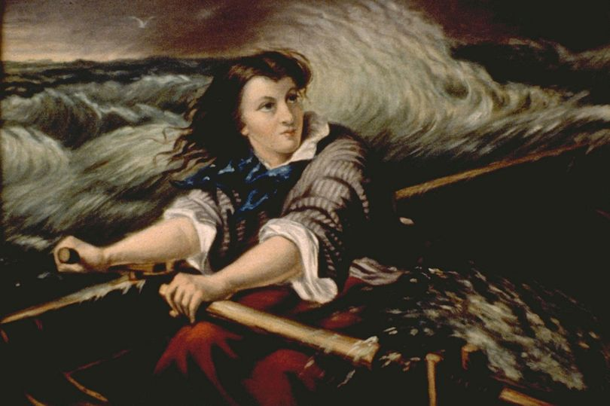
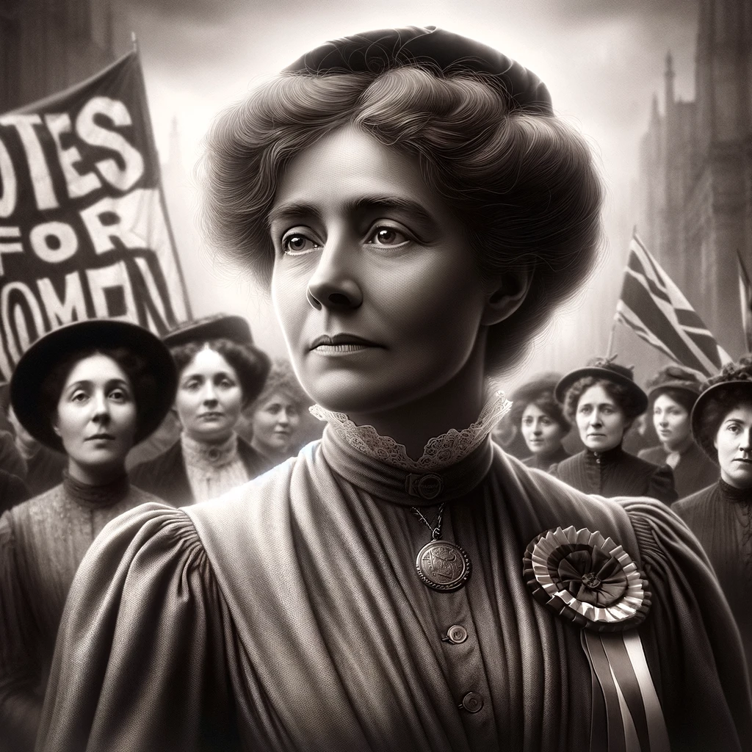
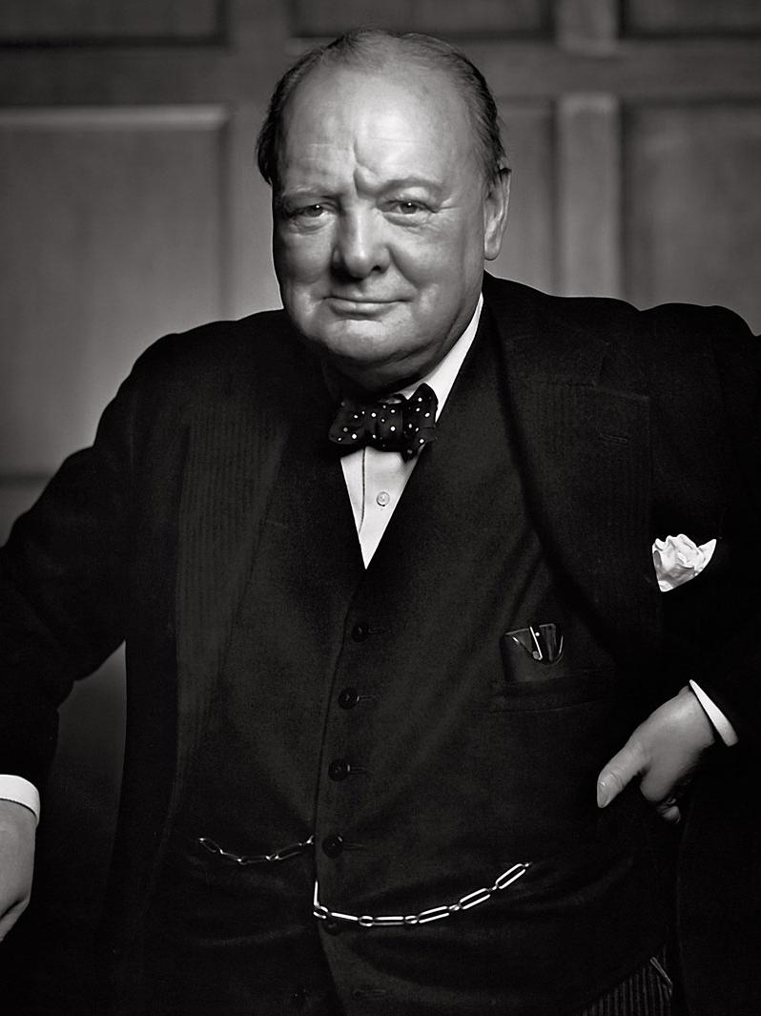



History at St Mary’s -
Together we love, learn and flourish
‘Let all you do be done with love’ 1 Corinthians 16:14
Our vision for History
We strive to create a learning environment where every child is inspired to explore the past with curiosity, courage, and compassion. We encourage pupils to develop their historical enquiry skills when learning about the people, events, and cultures that have shaped our world, nurturing a desire to ask questions, investigate sources, and seek deeper understanding.
We want our children to develop a deep curiosity about the lives of those who came before them—wondering what motivated people’s actions, how societies have changed over time, and how the past continues to influence the present. We encourage them to approach historical learning with courage, engaging thoughtfully with diverse perspectives, and sometimes uncomfortable truths, so that as a society we do not repeat the mistakes of the past. Through this, they grow in confidence as critical thinkers and active learners. We want our children to have compassion—for people in history, for each other, and for the world they are helping to shape. Our history curriculum encourages empathy, open-mindedness, and respect, helping children to understand the human stories behind historical events and to reflect on how they can contribute to a more just and inclusive future.
Inspiring our children
Children will be inspired by learning about significant people from history, such as Grace Darling, Emmeline Pankhurst and Winston Churchill.
How is History taught at St Mary’s?
At St Mary’s History is taught through practical activities, and focusing on key historical concepts like chronology, similarities, differences, and evidence.
In EYFS, children explore their own history, such as organising events from their lives on a timeline or comparing accessible and relatable artefacts, such as old and new toys. As the children develop their knowledge of historical concepts, such as chronology, the children in KS1 begin to explore significant individuals from history who made a historical impact. In lower and upper key stage 2, the children have opportunity to learn about an ancient civilisation, comparing historical concepts, such as democracy and societal structures, including hierarchy and monarchy. Throughout KS2, the children will learn about British history and its chronology, from the Stone Age to post-war Britain.
Lessons aim to inspire curiosity through engaging content such as timelines, artefacts, and educational visits. The goal is to help children understand the past, connect it to the present, and develop foundational knowledge and historical vocabulary.
Our long-term plan provides an overview of the units taught in each year group, with key concepts of chronology, significance and enquiry woven throughout.
CHRONOLOGY
ENQUIIRY

