Slide 1



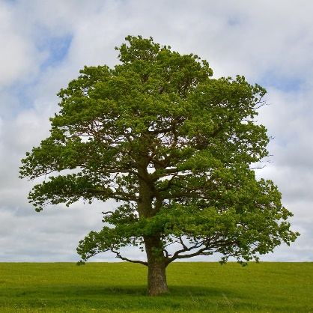




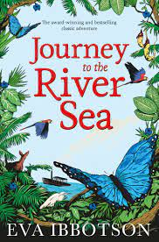
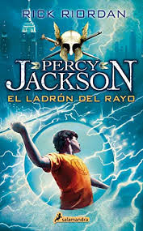








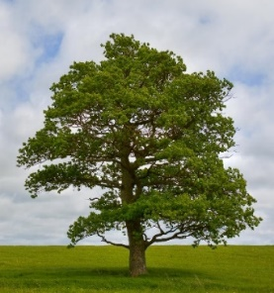
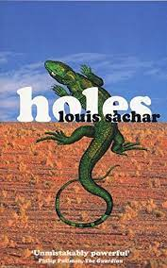


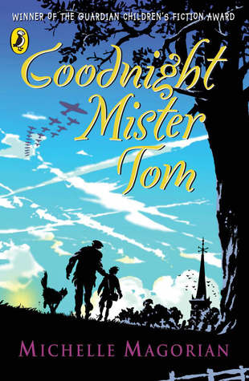
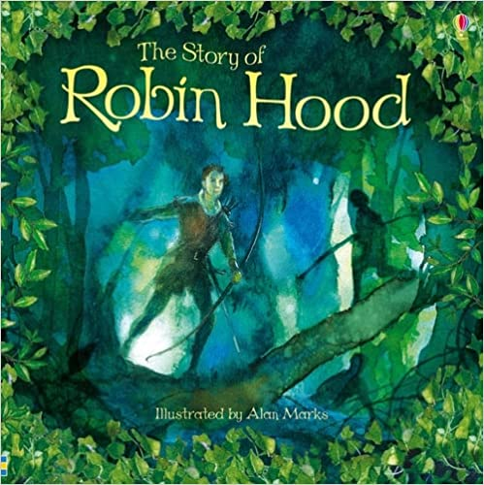
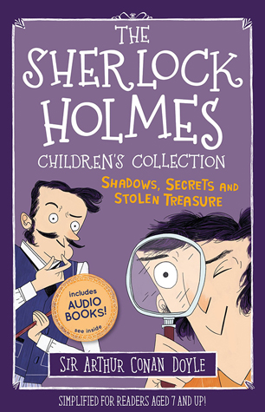
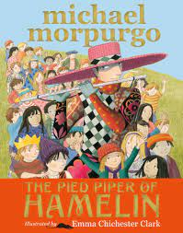
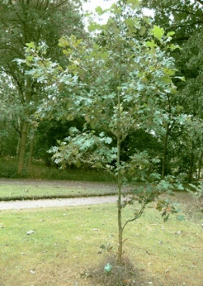
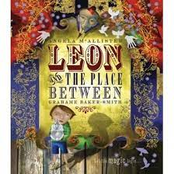
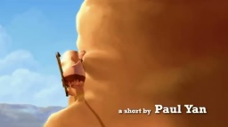


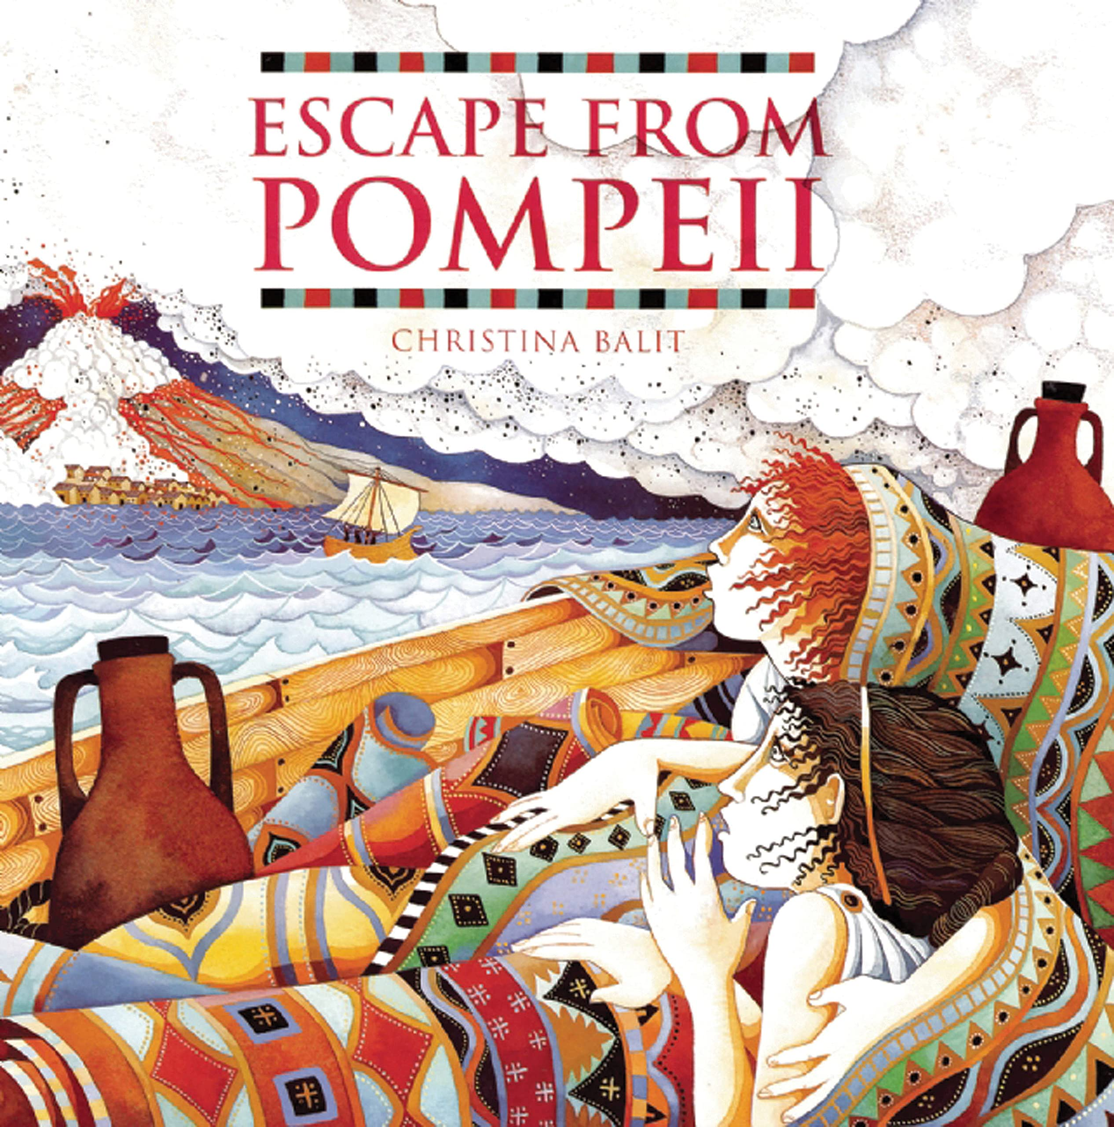

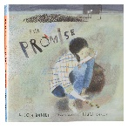
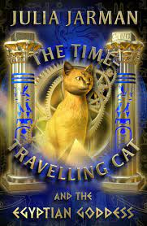


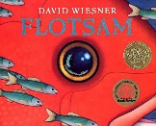
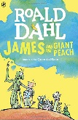
“Thus says the Lord, the God of Israel: Write in a book all the words that I have spoken to you.”
Deuteronomy 28:12
Key Concepts
(found throughout each unit)
Spelling/ Phonic Knowledge
Handwriting
Vocabulary, Grammar & Punctuation
Composition (including editing)
5-6 B
A Brief Overview of Teaching Strategies Adopted to Deliver Writing Across St Mary’s
All children are exposed to a range of quality texts as a stimulus for writing. Pie Corbett’s Talk4Writing techniques are adopted, which include the use of drama strategies, Reading as a Writer and text-mapping. Across school, children are also introduced the Sue Palmer writing skeletons for the six genres of non-fiction writing to support with organisational features and writing structures.
Modelled sentences and texts, such as WAGOLLs (What A Good One Looks Like) are used so children can analyse the text, identifying language (including grammar, spelling and punctuation) and organisational features. Teachers also adopt whole-class shared writing strategies and guided writing groups to support.
Working walls and vocabulary lists are evident in classrooms, which are often generated with the assistance of the children when exploring each quality text. Vocabulary books and spelling dictionaries are used throughout Key Stage 2.
SUM Fiction: Character Descriptions & Playscripts
SUM Non-Fiction & Poetry: Discussion texts & Sea Poetry
SUM Fiction: Adventure & Stories from other cultures
SUM Non-Fiction: Persuasion & Report
Y6 SPELLING | Y6 HANDWRITING | Y6 VOCABULARY, GRAMMAR & PUNCTUATION | Y6 COMPOSITION
S1) Distinguish between homophones and other words which are often confused. S2) Convert verbs into nouns by adding a suffix S3) Spell the commonly mis-spelt words from the Y5/6 word list. S4) Understand that the spelling of some words need to be learnt specifically. S5) Use any dictionary or thesaurus. S6) Use a range of spelling strategies | H3) Choose the style of handwriting to use when given a choice. H4) Choose the handwriting that is best suited for a specific task. | VGP1) Vary sentence structure to suit formal and informal writing. VGP2a) Use a variety of organisational and presentational devices appropriate to the text type. VGP2b) Write in paragraphs which can clearly signal a change in subject, time, place or event. VGP3) Proof read for spelling and punctuation errors. VGP4) Use a hyphen to avoid ambiguity. VGP6) Use the semi-colon, colon and dash, and use the colon to introduce a list and the semi-colon within lists. VGP7) Use the passive voice. | C1) Use a range of sentence starters to create specific effects, and use developed noun phrases to add detail to sentences. C2) Use layout devices such as headings, sub-headings, columns, bullets or tables C3) Sustain and develop ideas logically in narrative and non-narrative writing; Ensure the correct and consistent use of tense throughout C4a) Use grammatical structures and features and choose vocabulary appropriate to the audience, purpose and degree of formality to make meaning clear and create effect, and use commas to mark phrases and clauses. C4b) Use the passive voice to present information with a different emphasis. C5a) Identify the audience for and purpose of the writing. C5b) Choose the appropriate form and register for the audience and purpose of the writing. C6) Use character, dialogue and action to advance events in narrative writing. C7) Summarise a text, conveying key information in writing.
SPR Fiction: Fantasy Stories & Flashback Stories
SPR Non-Fiction: Persuasion & Non-Chronological Reports
Y5 SPELLING | Y5 HANDWRITING | Y5 VOCABULARY, GRAMMAR & PUNCTUATION | Y5 COMPOSITION
S1) Distinguish between homophones and other words which are often confused. S2) Form verbs with prefixes and convert nouns or adjectives into verbs by adding a suffix, understanding the rules for adding prefixes and suffixes. S3) Spell the commonly mis-spelt words from the Y5/6 word list. S4) Spell words with silent letters. S5) Use the first 3 or 4 letters of a word to check spelling, meaning or both in a dictionary; and use a thesaurus. S6) Use a range of spelling strategies. | H3) Choose the style of handwriting to use when given a choice. H4) Choose the handwriting that is best suited for a specific task. | VGP1) Use relative clauses. VGP2) Build cohesion between paragraphs, by using adverbials to link paragraphs. VGP3) Proof read for errors in spelling and punctuation VGP4) Use brackets, dashes and commas to indicate parenthesis. VGP6) Use commas to clarify meaning or avoid ambiguity. VGP7) Use adverbs or modal verbs to indicate a degree of possibility. | C1) Start sentences in different ways. C2) Organise my writing into paragraphs to show different information or events, and use further organisational & presentational devices to structure text and to guide the reader eg headings, statements, underlining C3) Ensure consistent and correct use of tense throughout. C4) Use grammar and vocabulary to create an impact on the reader, using stylistic devices to create effects in writing and add well-chosen detail to interest the reader. C5a) Discuss the audience and purpose of the writing. C5b) Use the correct features and sentence structure matched to the text type we are working on. C6) Develop characters through action and dialogue, and establish a viewpoint as the writer through commenting on characters and events. C7) Summarise a paragraph.
SPR Fiction: Science Fiction
SPR Non-Fiction & Poetry: Discussions, Recounts & Space Poetry
Fiction Genres
Classic Narrative
Stories from Other Cultures
Science Fiction
Fantasy
Flashback/Time-slip
Historical Stories
Adventure Stories
Playscripts
Traditional Tales
Fables, Myths & Legends
Mystery/Crime
Stories with a Familiar Setting
Dilemmas
Non-Fiction Genres
Recount
Report
Explanation
Instruction
Persuasion
Discussion
Poetry
Shape Poems
Performance Poetry
Creating Imagery
Classic Poetry
Based on a Theme
Style & Form
5-6 A
AUT Fiction: Historical stories & Classic Narrative
AUT Non-Fiction & Poetry: Explanation & Poetic Style
AUT Fiction: Crime novels & Stories from other cultures
AUT Non-Fiction & Poetry: Explanation & The Highwayman
SUM Fiction: Mystery & Legends
SUM Non-Fiction & Poetry: Persuasion & Shape Poetry
SUM Fiction: Fantasy Stories & Traditional (European) Tales
SUM Non-Fiction: Non-Chronological Reports
3-4 B
Y4 SPELLING | Y4 HANDWRITING | Y4 VOCABULARY, GRAMMAR & PUNCTUATION | Y4 COMPOSITION
S1) Recognise and spell homophones. S2) Spell words with prefixes and suffixes and can add them to root words. S3) Spell the commonly mis-spelt words from the Y3/4 word list. S5) Use the first two or three letters of a word to check a spelling in a dictionary. S6) Write from memory simple sentences dictated by the teacher that include words and punctuation already taught. | H1) Handwriting is legible and consistent; down strokes of letters are parallel and equidistant; lines of writing are spaced sufficiently so that ascenders and descenders of letters do not touch. H3) Use the diagonal and horizontal strokes that are needed to join letters and understand which letters should be left unjoined. | VGP1) Use noun phrases which are expanded by adding modifying adjectives, nouns and preposition phrases. VGP2) Write in paragraphs. VGP3) Proof read for spelling and punctuation errors. VGP4) Use inverted commas and other punctuation to indicate direct speech. VGP5) Make an appropriate choice of pronoun and noun within and across sentences. VGP6) Use apostrophes to mark plural possession and use commas after fronted adverbials. VGP7) Use standard forms for verb inflections instead of local spoken forms eg ‘we were’ not ‘we was’ | C1) Compose sentences using a range of sentence structures, including using a range of sentences which have more than one clause. C2) Discuss and record ideas, orally rehearsing a sentence or a sequence of sentences. C3) Improve my writing by changing grammar and vocabulary to improve consistency. C4) Apply VGP skills to my writing; such as use appropriate nouns and pronouns within and across sentences to support cohesion and avoid repetition; and use direct speech in my writing and punctuate it correctly. C5) Write a narrative with a clear structure, setting and plot.
SPR Fiction: Dilemmas & Historical Stories
SPR Non-Fiction & Poetry: Explanations, Haikus & Cinquains
Y3 SPELLING | Y3 HANDWRITING | Y3 VOCABULARY, GRAMMAR & PUNCTUATION | Y3 COMPOSITION
S1) Recognise and spell homophones. S2) Spell words with additional prefixes and suffixes and understand how to add them to root words. S3) Spell the commonly mis-spelt words from the Y3/4 word list. S4) Use the correct form of ‘a’ or ‘an’ S5) Use the first two or three letters of a word to check its spelling in a dictionary. S6) Spell words which are in a family correctly. | H1) Handwriting begins to show awareness of ascending and descending letters. H3) Use the diagonal and horizontal strokes that are needed to join letters and understand which letters should be left unjoined. | VGP1) Express time, place and cause by using conjunctions, adverbs and prepositions. VGP2) Start to use paragraphs. VGP4) Use inverted commas to punctuate direct speech. VGP6) Use headings and sub headings. VGP7) Use the present perfect form of verbs instead of the simple past. | C1) Compose sentences using a wider range of structures; using a range of sentences with more than one clause by using a range of conjunctions. C2) Discuss and record ideas. C3a) Proof-read to check for errors in spelling and punctuation. C3b) Suggest improvements to my own writing and that of others and make improvements to grammar, vocabulary and punctuation. C4) Apply VGP skills to my writing; such as use the perfect form of verbs to mark the relationship of time and cause. C5a) Discuss models of writing, noting its structure, grammatical features and use of vocabulary. C5b) Write a narrative with a clear structure, setting, characters and plot; Produce non-narrative writing using simple organisational devices such as headings and sub-headings.
SPR Fiction: Historical Stories
SPR Non-Fiction & Poetry: Recount, Chronological Report & Creating Imagery
Themes and Values
Justice
Love
Endurance
Forgiveness
Dignity
Thankfulness
British
Values
Wider
World
AUT Fiction: Stories with a familiar setting & Adventure stories
AUT Non-Fiction: Non-chronological reports & Instructions
AUT Fiction: Adventure Stories & Science fiction
AUT Non-Fiction & Poetry: Instructions & Story–inspired poetry
3-4 A
WRITING: We aim to develop children’s love for writing whilst enabling them to gain the necessary communication skills to be successful learners and citizens, empowered to take their place in and contribute to a just society.
ART & DESIGN

Slide 2
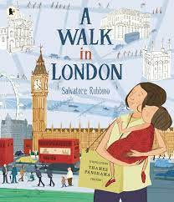
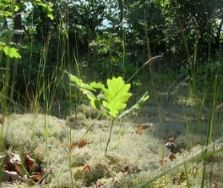
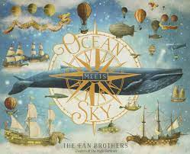
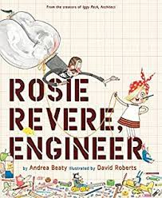
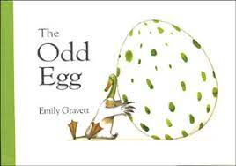

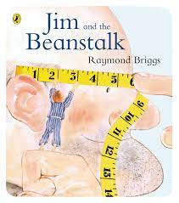
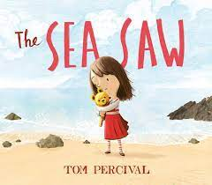
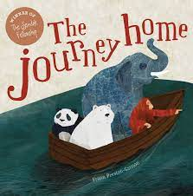


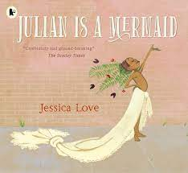
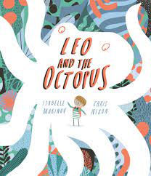
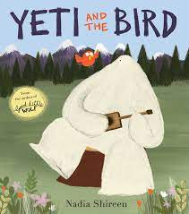
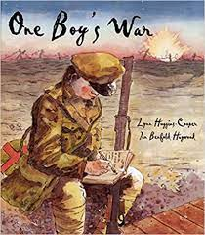
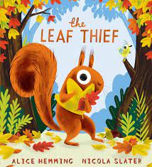
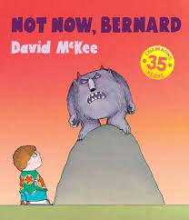
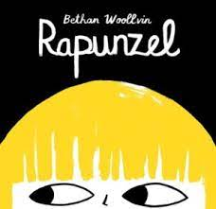
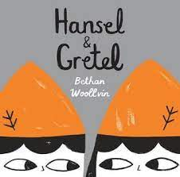
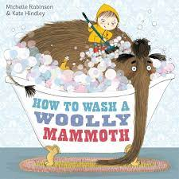
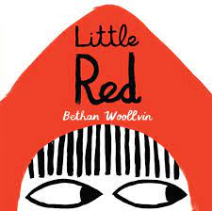
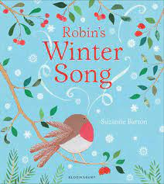

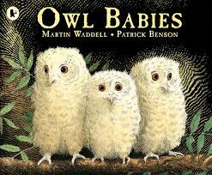

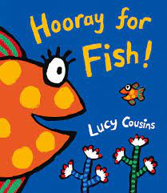
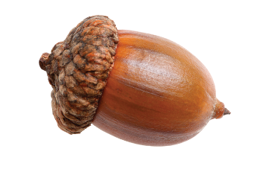
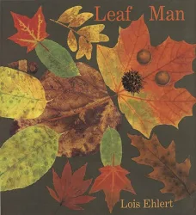
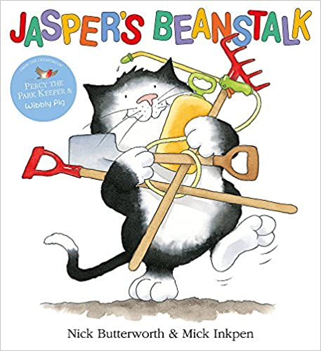


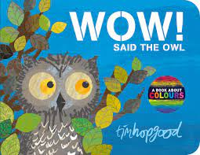
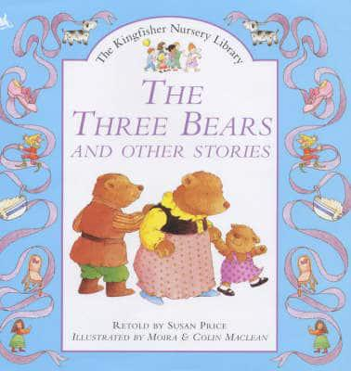
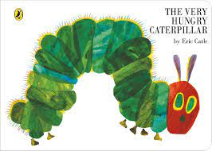
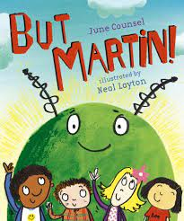
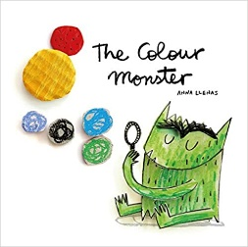
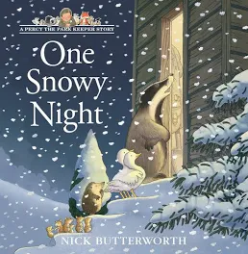

“Thus says the Lord, the God of Israel: Write in a book all the words that I have spoken to you.”
Deuteronomy 28:12
Key Concepts
(found throughout each unit)
Spelling/ Phonic Knowledge
Handwriting
Vocabulary, Grammar & Punctuation
Composition (including editing)
1-2B
A Brief Overview of Teaching Strategies Adopted to Deliver Writing Across St Mary’s
All children are exposed to a range of quality texts as a stimulus for writing. Pie Corbett’s Talk4Writing techniques are adopted, which include the use of drama strategies, Reading as a Writer and text-mapping. Across school, children are also introduced the Sue Palmer writing skeletons for the six genres of non-fiction writing to support with organisational features and writing structures.
Modelled sentences and texts, such as WAGOLLs (What A Good One Looks Like) are used so children can analyse the text, identifying language (including grammar, spelling and punctuation) and organisational features. Teachers also adopt whole-class shared writing strategies and guided writing groups to support.
Working walls and vocabulary lists are evident in classrooms, which are often generated with the assistance of the children when exploring each quality text. Vocabulary books and spelling dictionaries are used throughout Key Stage 2.
SUM Fiction: Fantasy & Stories with a familiar setting
SUM Non-Fiction: Information & Recounts
SUM Fiction: Traditional Tales with a Modern Twist
SUM Non-Fiction: Recounts & Information texts
Y2 SPELLING | Y2 HANDWRITING | Y2 VOCABULARY, GRAMMAR & PUNCTUATION | Y2 COMPOSITION
S1) Spell words with alternatives spellings, including a few common homophones. S2) Spell longer words using suffixes such as ‘ly’, ‘er’, ‘est’. S3) Segment spoken words into phonemes and record these as graphemes, and use my knowledge of alternative phonemes to narrow down possibilities for accurate spelling. S4) Identify phonemes in unfamiliar words and use syllables to divide words. | H1) Form lower-case letters of the correct size relative to one another, and use capital letters and digits of the correct size, orientation and relationship to one another and to lower case letters. H2) Use spacing between words that reflects the size of the letters. H3) Begin to use some of the diagonal and horizontal strokes needed to join letters and know which letters are best left unjoined. | VGP1) Use subordination and co-ordination. VGP2) Use expanded noun phrases. VGP3) Say how the grammatical patterns in a sentence indicate its function. VGP4) Use question marks and exclamation marks correctly. VGP5) Use capital letters for names of people, places, days of the week and the personal pronoun ‘I’. VGP6) Use commas to separate items in a list, use apostrophes to show where letters are missing and to mark singular possession in nouns. VGP7) Consistently use the present tense and past tense correctly, and use the progressive forms of verbs in the present and past tense. | C1) Orally rehearse structured sentences or sequences of sentences. C2) Plan and discuss the content of writing and record my ideas, encapsulating what I want to say sentence by sentence. C3) Proof-read to check for errors in spelling, grammar and punctuation and evaluate my own writing independently, with friends and with an adult. C5a) Write narratives about personal experiences and those of others, both real and fictional. C5b) Write for different purposes, including real events.
SPR Fiction: Stories with a familiar setting
SPR Non-Fiction: Instructions & Recounts
SPR Fiction: Adventure Stories
SPR Non-Fiction: Recounts & Information
Y1 SPELLING | Y1 HANDWRITING | Y1 VOCABULARY, GRAMMAR & PUNCTUATION | Y1 COMPOSITION
S1) Name all the letters of the alphabet in order and use letter names to show alternative spellings of the same phoneme. S2) Use the spelling rule for adding ‘s’ or ‘es’ for verbs in the 3rd person singular. S3) Use syllables to divide words when spelling and use what I know about alternative phonemes to narrow down possibilities for accurate spelling. S4) Identify known phonemes in unfamiliar words. | H1) Form lower case letters in the correct direction, starting and finishing in the right place; and can form capital letters and digits 0-9. H2) Sit correctly at a table, holding a pencil comfortably and correctly, separating words using finger spaces. | VGP1) Combine words to make a sentence and join two sentences using ‘and’. VGP2) Sequence sentences to form a narrative. VGP3) Use capital letters to start a sentence and use a full stop to end a sentence. VGP4) Use a question mark and an exclamation mark. VGP5) Use capital letters for names and use ‘I’. | C1) Compose a sentence orally before writing it. C2) Sequence sentences in chronological order to recount an event or experience. C3) Re-read what I have written to check that it makes sense. C4) Apply spelling rules when writing, e.g. Know how the prefix ‘un’ can be added to words to change meaning; and use the suffixes ‘s’, ‘es’, ‘ed’, and ‘ing’ within my writing.
Fiction Genres
Classic Narrative
Stories from Other Cultures
Science Fiction
Fantasy
Flashback/Time-slip
Historical Stories
Adventure Stories
Playscripts
Traditional Tales
Fables, Myths & Legends
Mystery/Crime
Stories with a Familiar Setting
Dilemmas
Non-Fiction Genres
Recount
Report
Explanation
Instruction
Persuasion
Discussion
Poetry
Shape Poems
Performance Poetry
Creating Imagery
Classic Poetry
Based on a Theme
Style & Form
AUT Fiction: Fantasy
AUT Non-Fiction: Report & Instructions
AUT Fiction: Traditional Stories with a Modern Twist
AUT Non-Fiction: Recounts & Instructions
1-2 A
R
YR SPELLING | YR HANDWRITING | YR VOCABULARY, GRAMMAR & PUNCTUATION | YR COMPOSITION
S1) Spell words by identifying sounds in them and representing the sounds with a letter or letters. | H1) Write recognisable letters, most of which are correctly formed. | VGP1) Use and understand recently introduced vocabulary during discussions about stories, non-fiction, rhymes and poems and during role-play. | C1) Write simple phrases and sentences that can be ready by others.
Themes and Values
Justice
Love
Endurance
Forgiveness
Dignity
Thankfulness
British
Values
Wider
World
WRITING: We aim to develop children’s love for writing whilst enabling them to gain the necessary communication skills to be successful learners and citizens, empowered to take their place in and contribute to a just society.
ART & DESIGN

